Slide 1
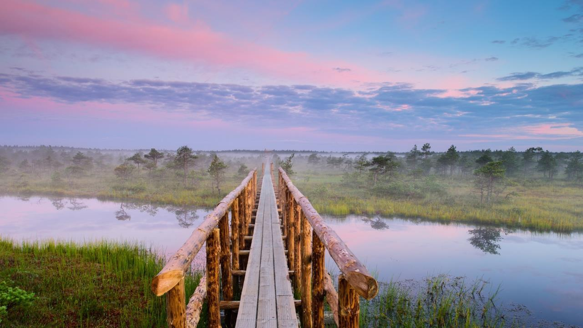


MEET ESTONIA
Small in Size, Big in Experiences!

Slide 2
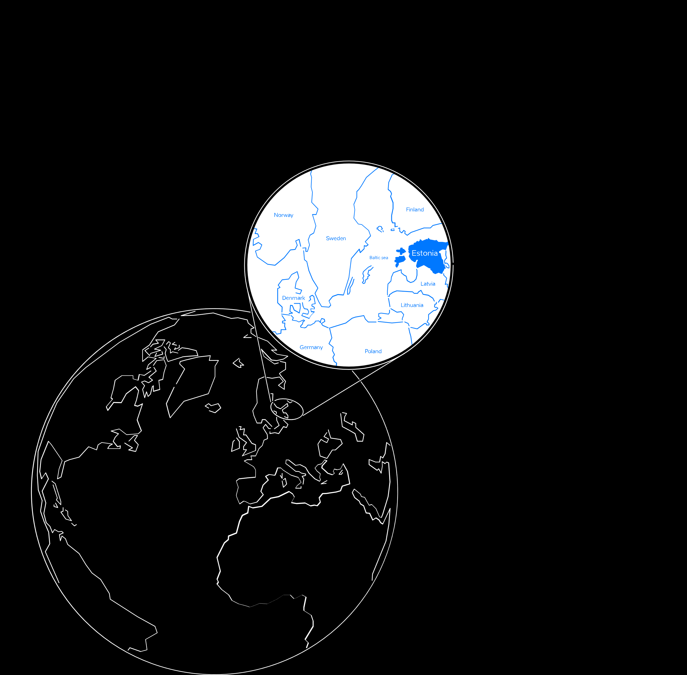
Estonia in a Nutshell
population: 1.3 million
currency: EUR
official language: Estonian, English widely spoken
member of: EU, Eurozone, OECD, NATO and Schengen
capital city: Tallinn (450,000)

Slide 3
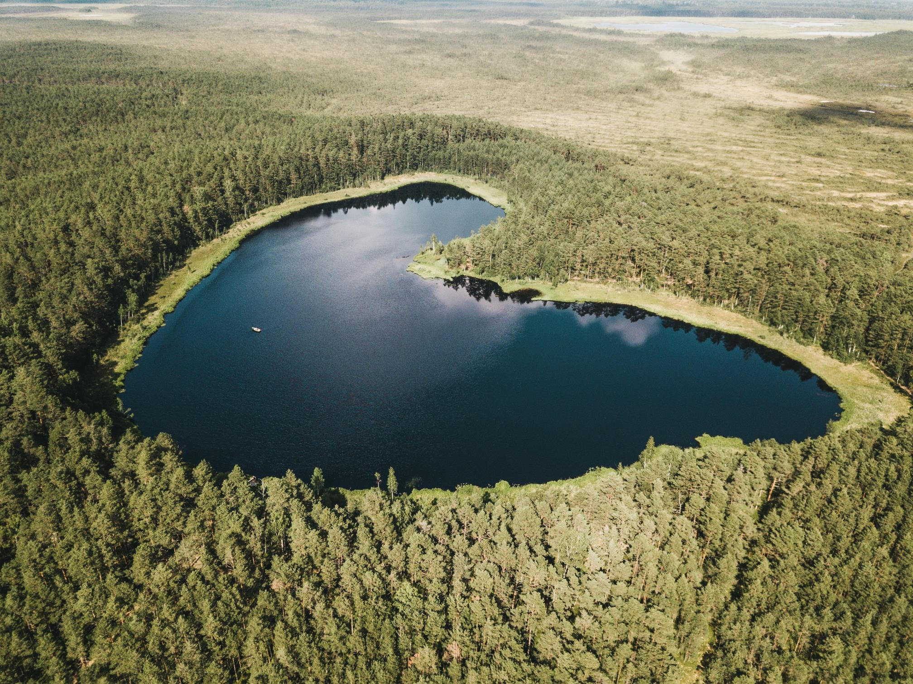
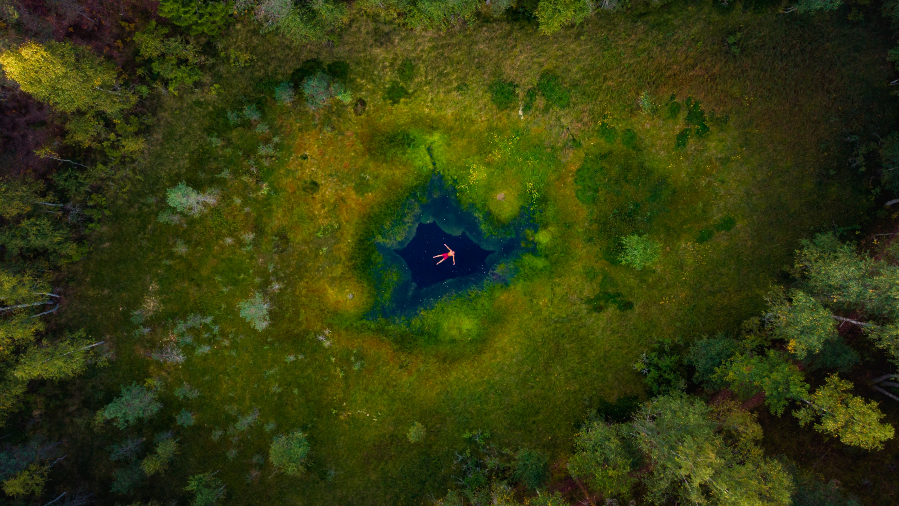
nature is only ever a heartbeat away & sustainability is a lifestyle
Green & clean where nature is only a heartbeat away
© Jaan Roose
70% of the country covered by wilderness (forests, wetlands)
2,222 islands
drinkable tap water
Cleanest air & low level of noise pollution
Small-scale, walkable cities
local seasonal food
honouring local traditions
Green Key certified hotels, restaurants and venues
70% of the country covered by wilderness (forests, wetlands)
2,222 islands

Slide 4
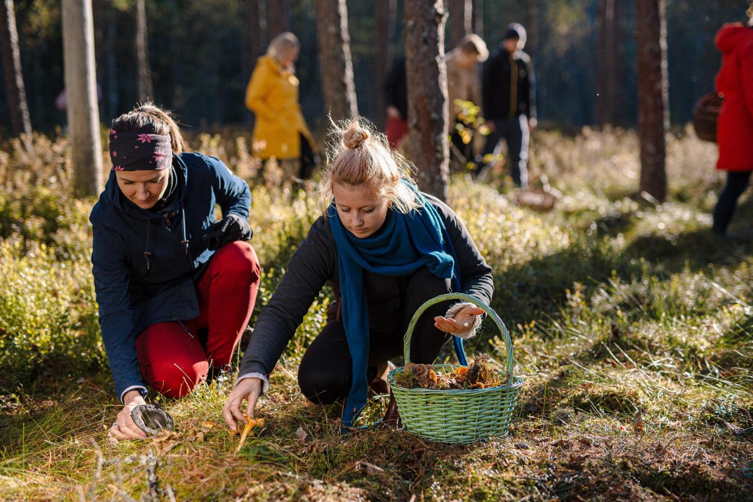
sustainability is a lifestyle
#4th in global sustainability travel index
drinkable tap water
local seasonal food
cleanest air & low level of noise pollution
small-scale, walkable cities
Green Key certified hotels, restaurants and venues

Slide 5
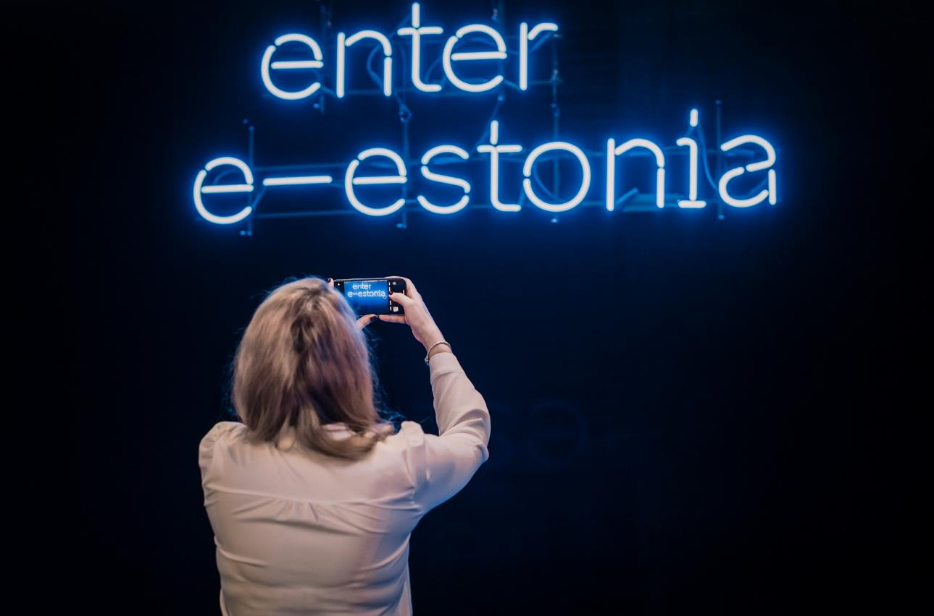
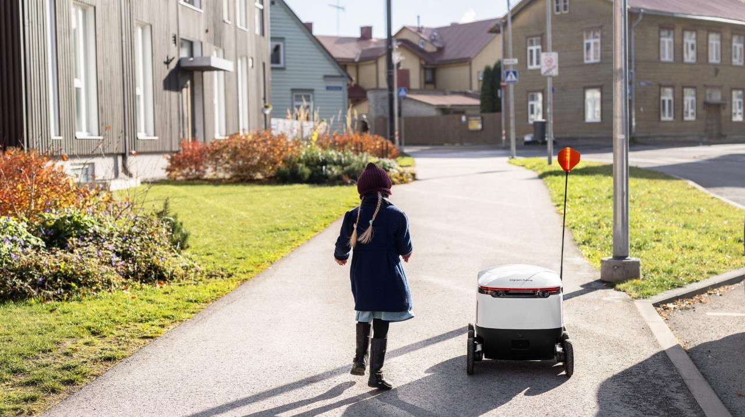



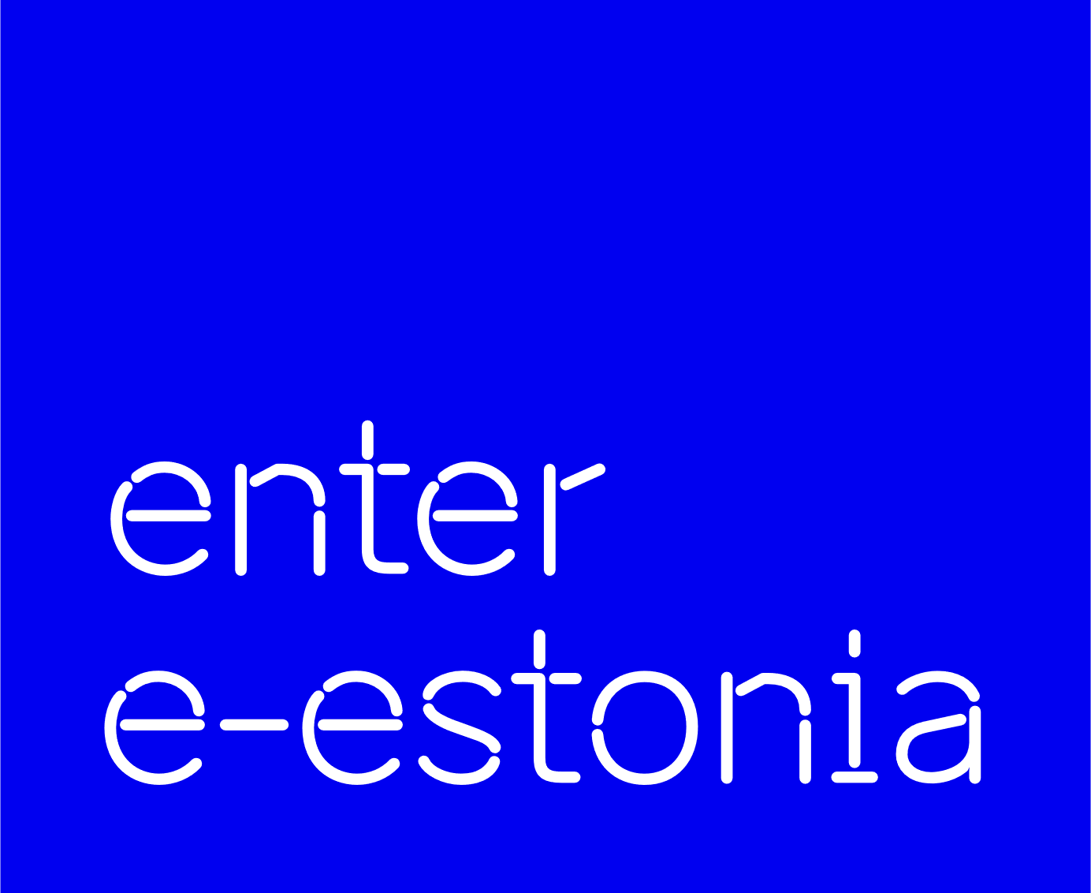







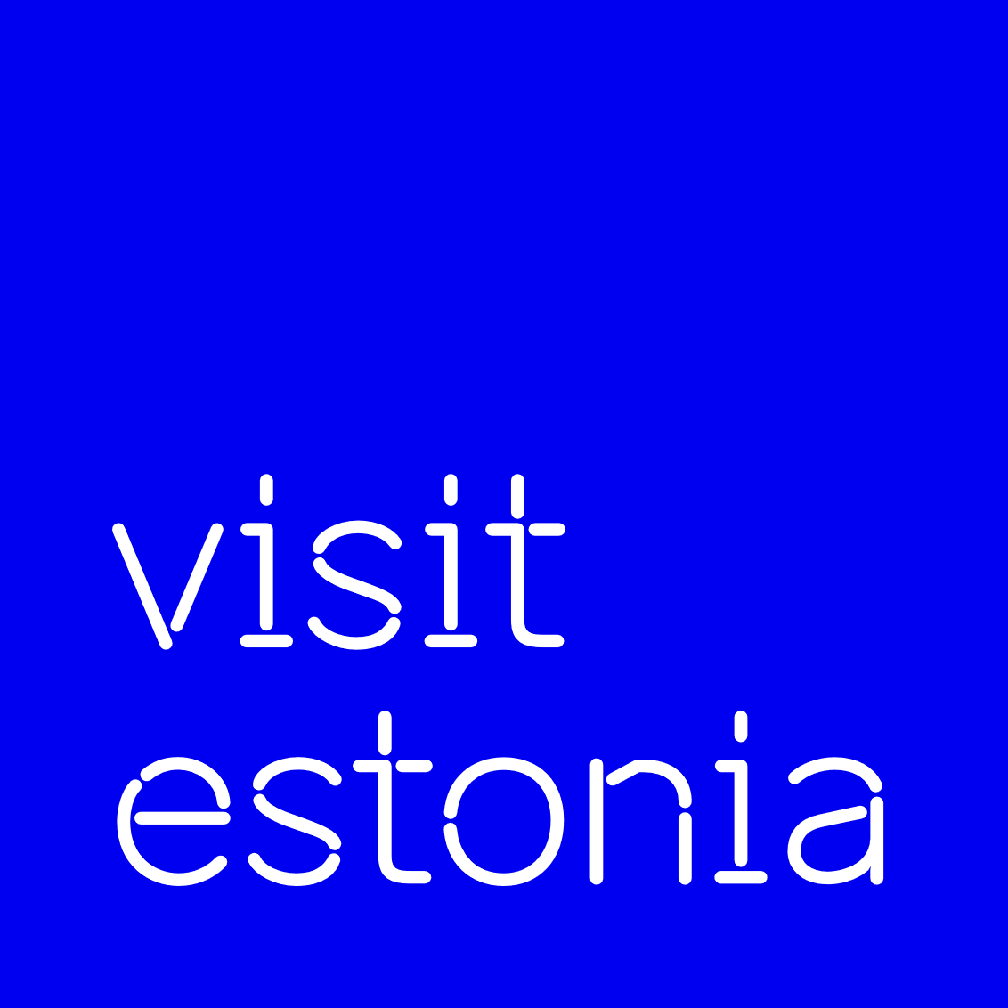












© Renee Altrov
Most advanced digital society in the world: 99% state services are online
Electronic ID, I- voting, E-health, E-School, E-Tax
Documents signed digitally in seconds
E-Residency - digital identity for foreign nationals to access our digital services

Slide 6
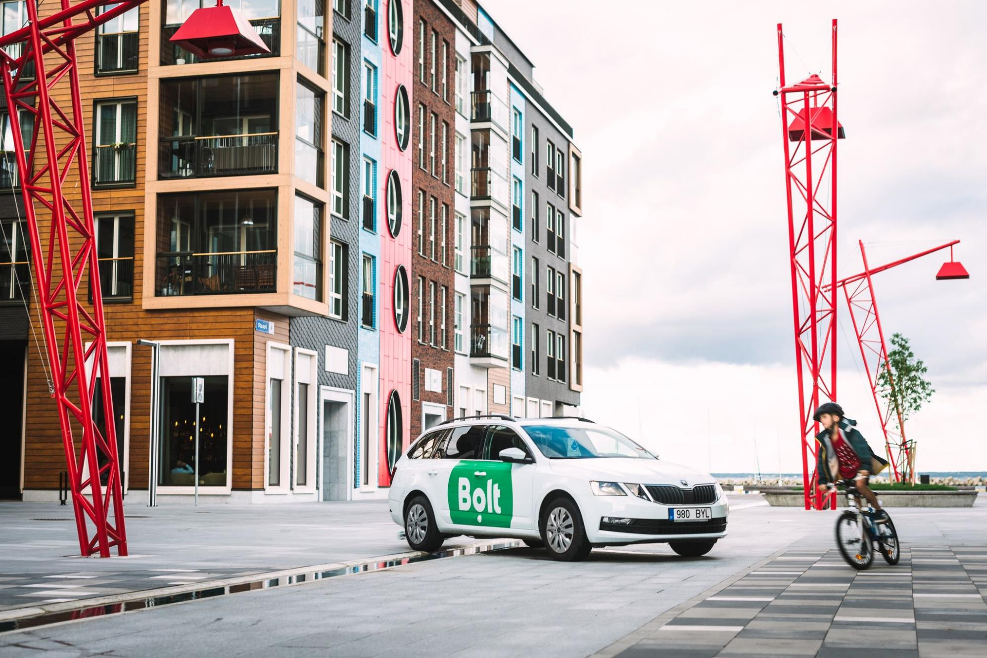
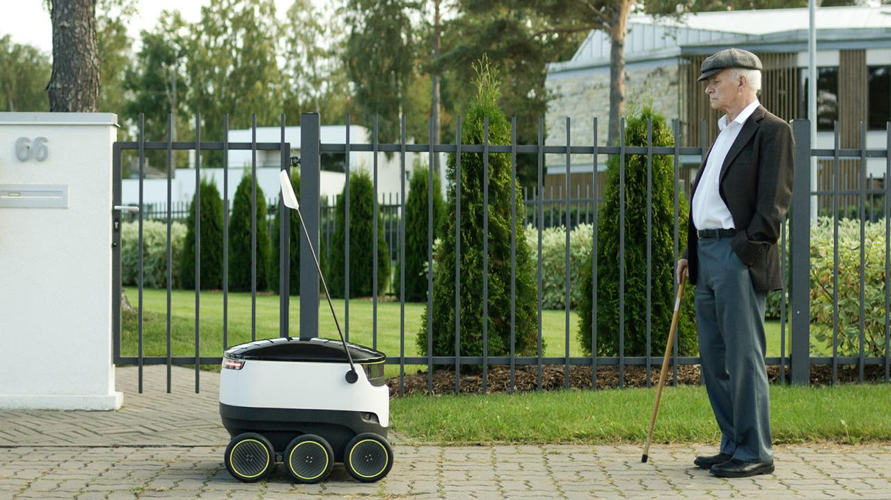
Land of Startups
Land of Startups
© Ajujaht
1400+ startups
10 unicorns - #1 per capita in Europe
raised around € 3.5B in funding since 2010
Estonian Startup Visa & Scale-up Visa
supportive ecosystem

Slide 7
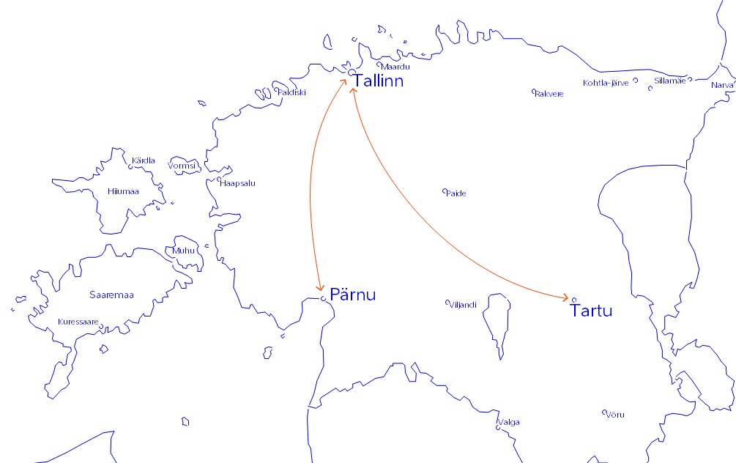



Main cities for events

Slide 8
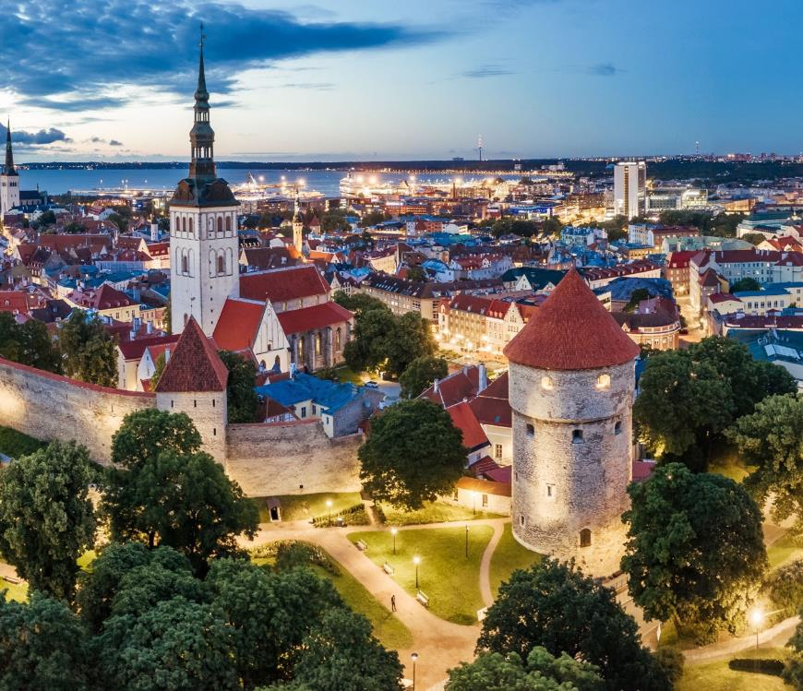
Tallinn
UNESCO Heritage listed medieval
Old Town
Population: 450,000

Slide 9
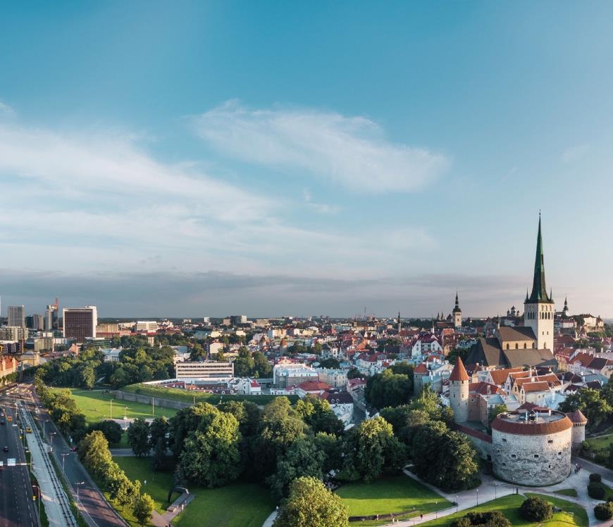
Sustainable
Cosy Compact
Most sights, hotels, venues, restaurants are within walking distance

Slide 10
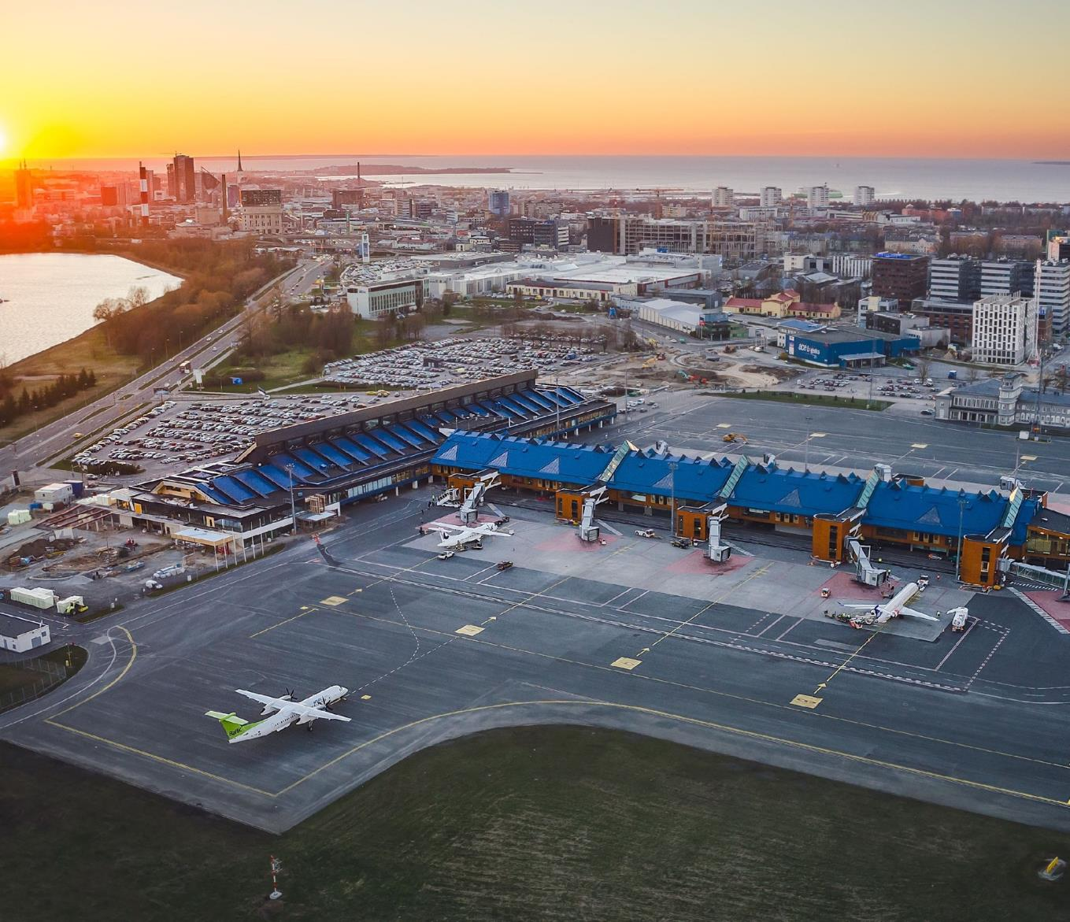
International Tallinn
Airport
Located 4 km from the city center
2023 Best Airport in the world, among those serving 2-5 million passengers per year (by Airports’ Council International)

Slide 11
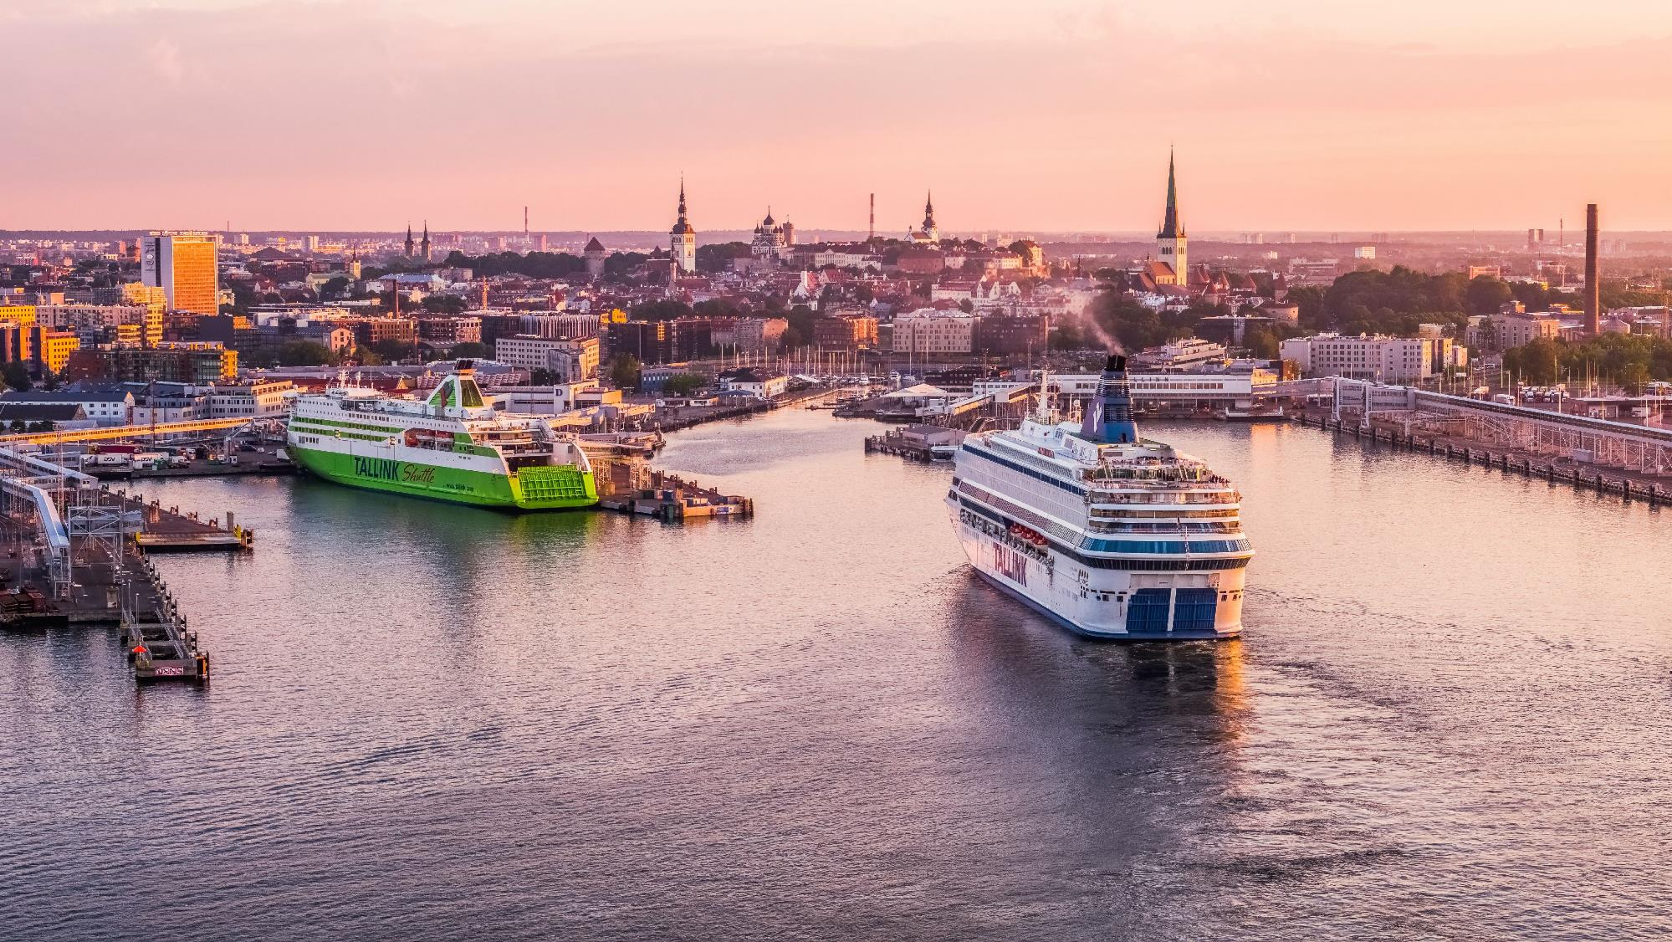
© Visit Tallinn
Port of Tallinn

Slide 12
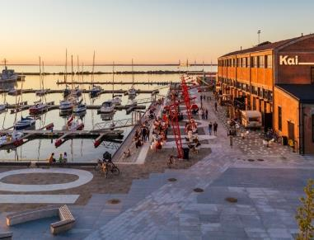
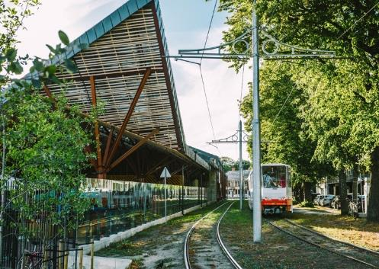
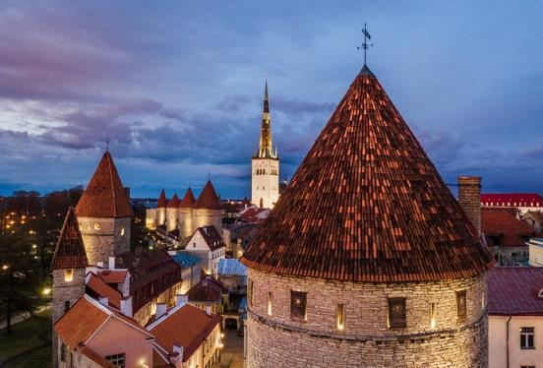
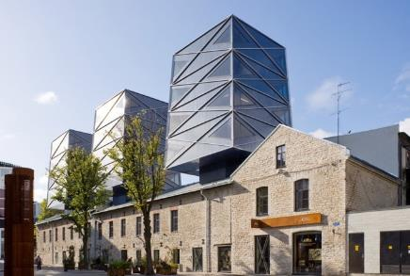
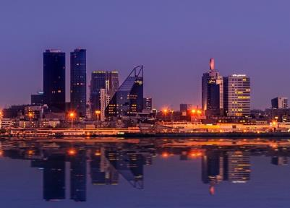
A diversity of colourful neighbourhoods gives Tallinn
a unique
flavour

Slide 13
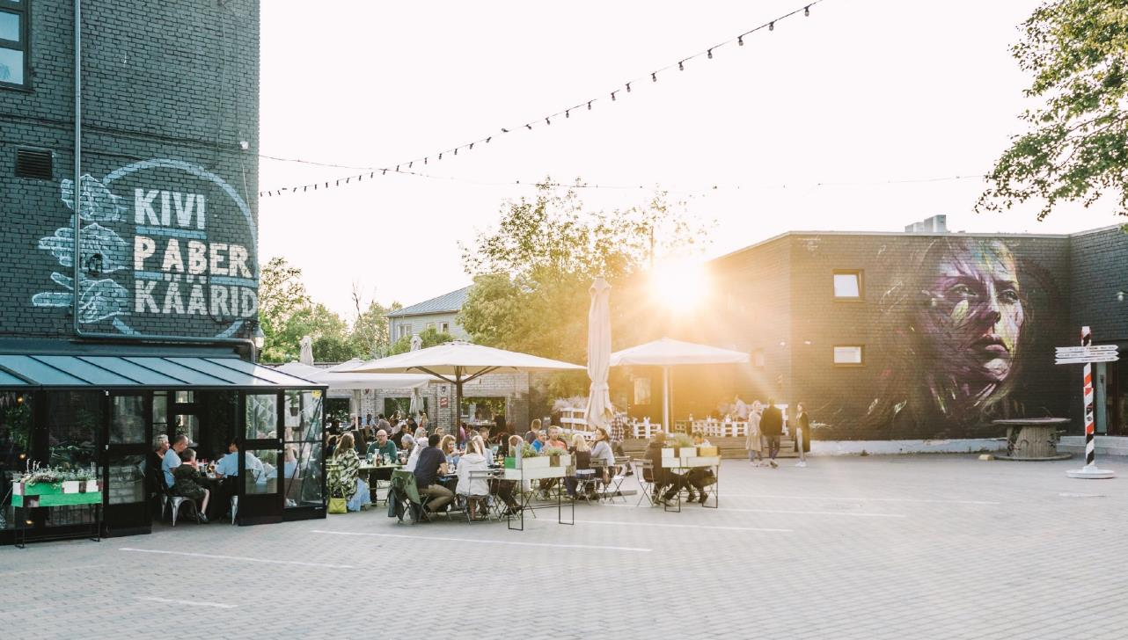
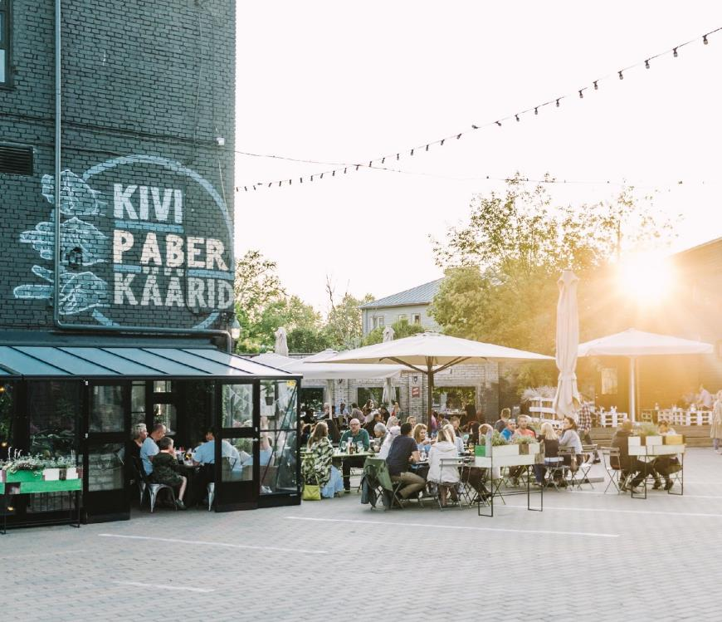
Telliskivi Creative City
Bohemian, Funky, Hipster district located in a former industrial complex

Slide 14
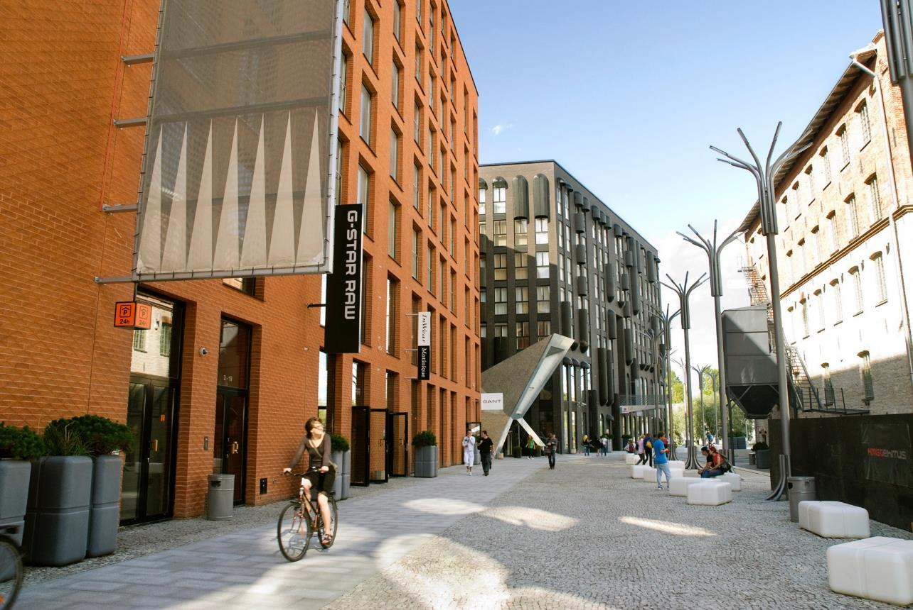
Rotermanni Quarter
A reclaimed factory district now
a fashionable residential and
office area with cool bars and restaurants loved by the locals

Slide 15
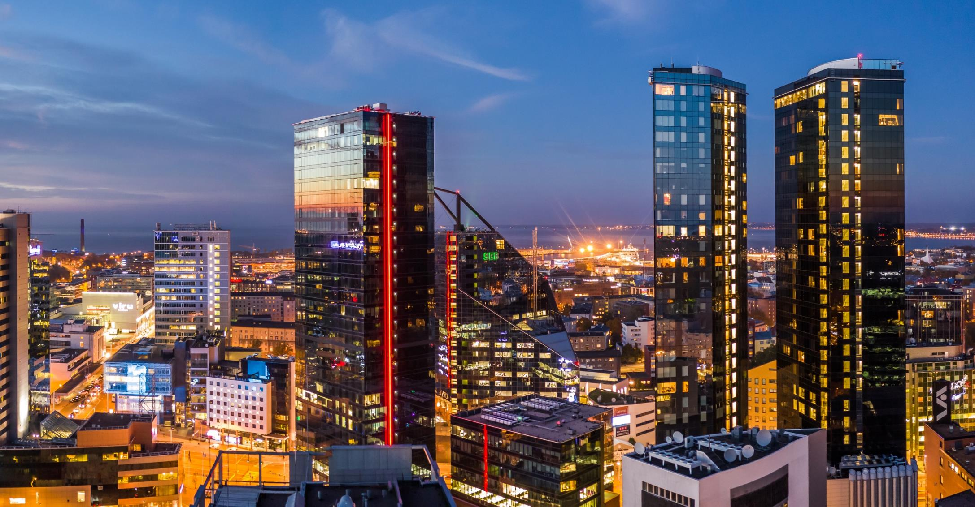
Maakri Business District

Slide 16
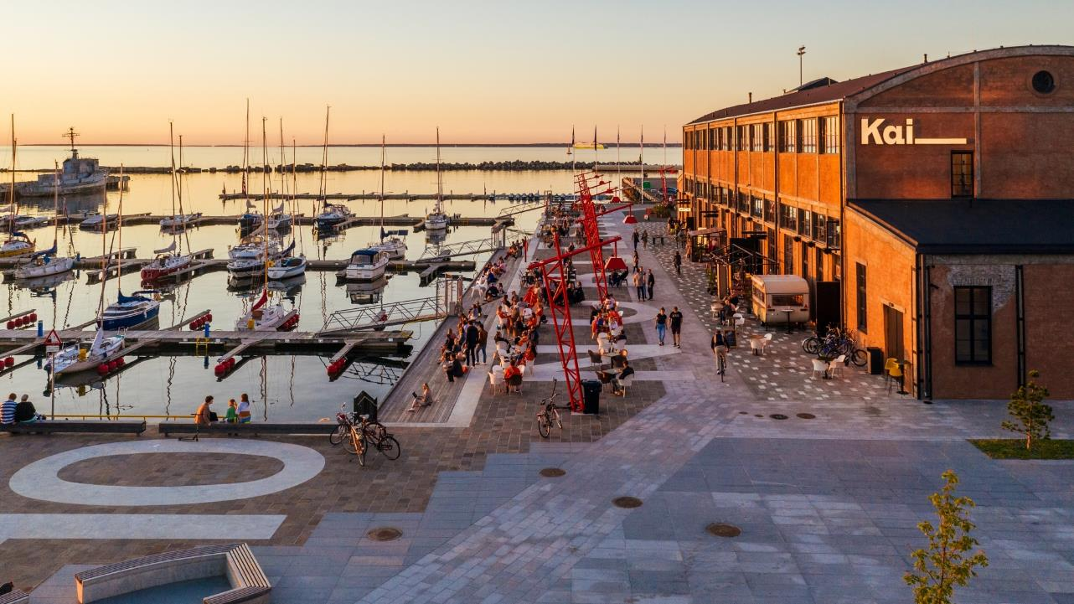
Noblessner Port District
Former submarine shipyard turned into popular seafront quarter

Slide 17
Awe-inspiring Unique venues

Slide 18
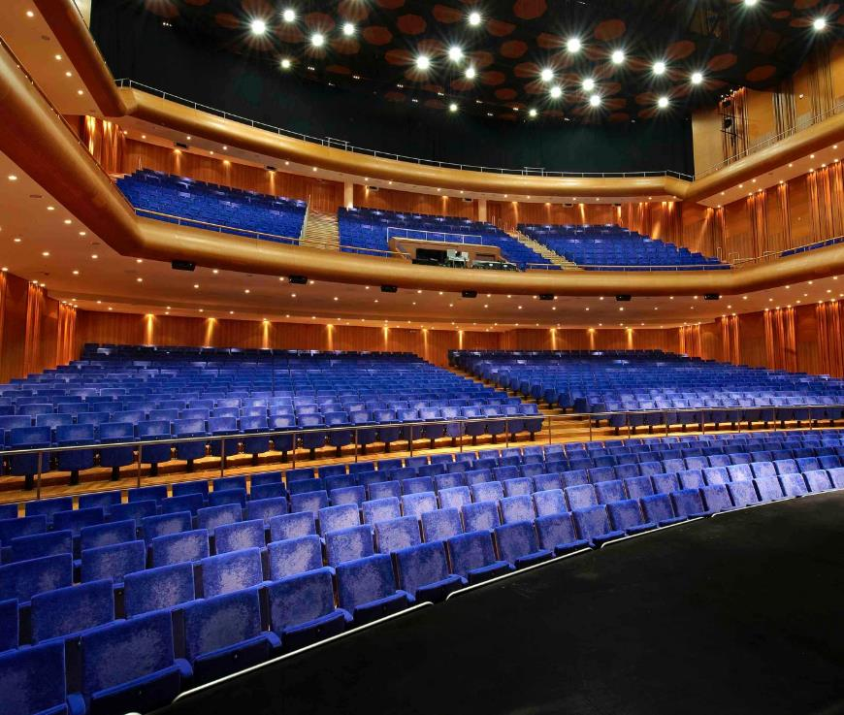
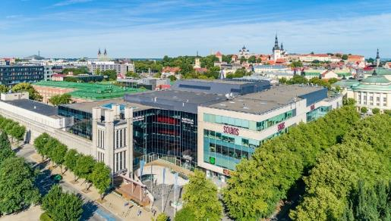
Alexela Concert Hall
1 ,829 pax seated in grand hall
9 cinema rooms
3,300 m2 of multifunctional foyers

Slide 19
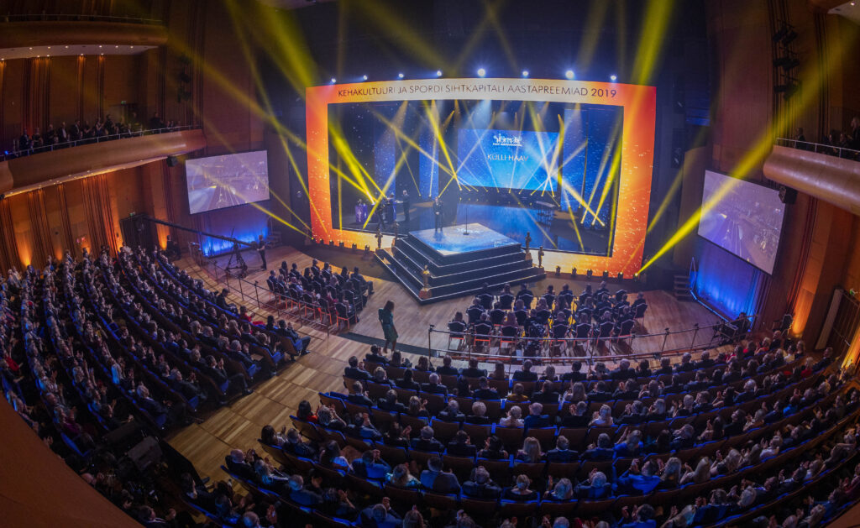
Alexela Concert Hall

Slide 20
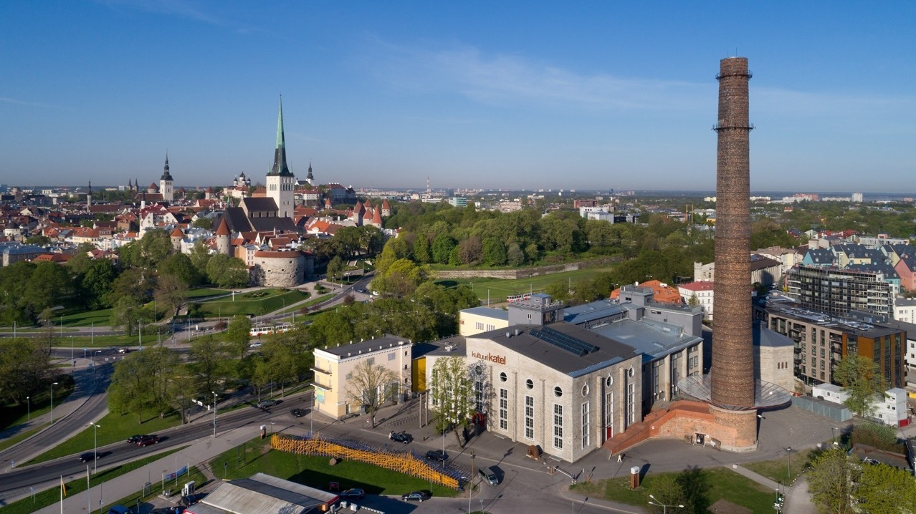
Tallinn Creative Hub
Valokuva: Toomas Tuul
A historic power station turned into a multifunctional event venue
19 meeting rooms

Slide 21
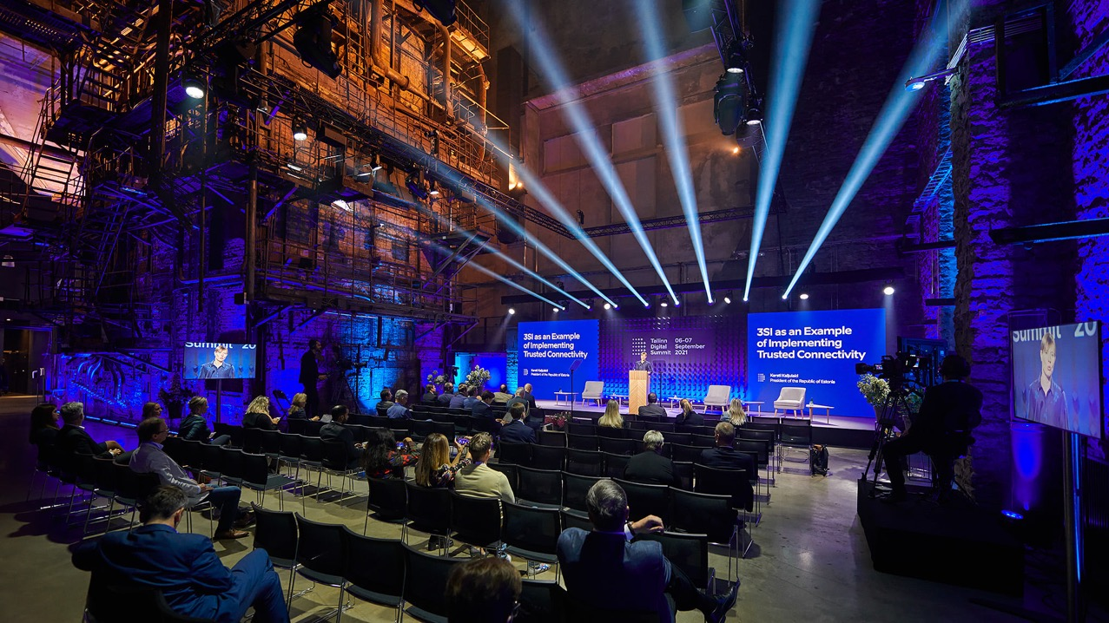
Tallinn Creative Hub
:
cauldron hall 250 guests

Slide 22
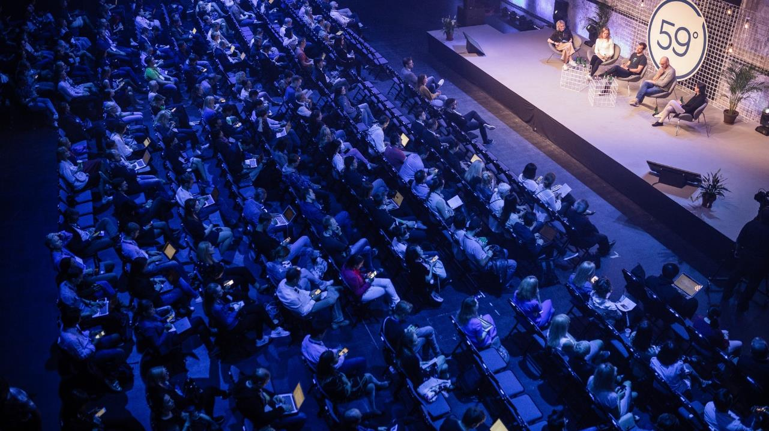
Tallinn Creative Hub
Black box 600 guests

Slide 23
Seaplane Harbour

Slide 24
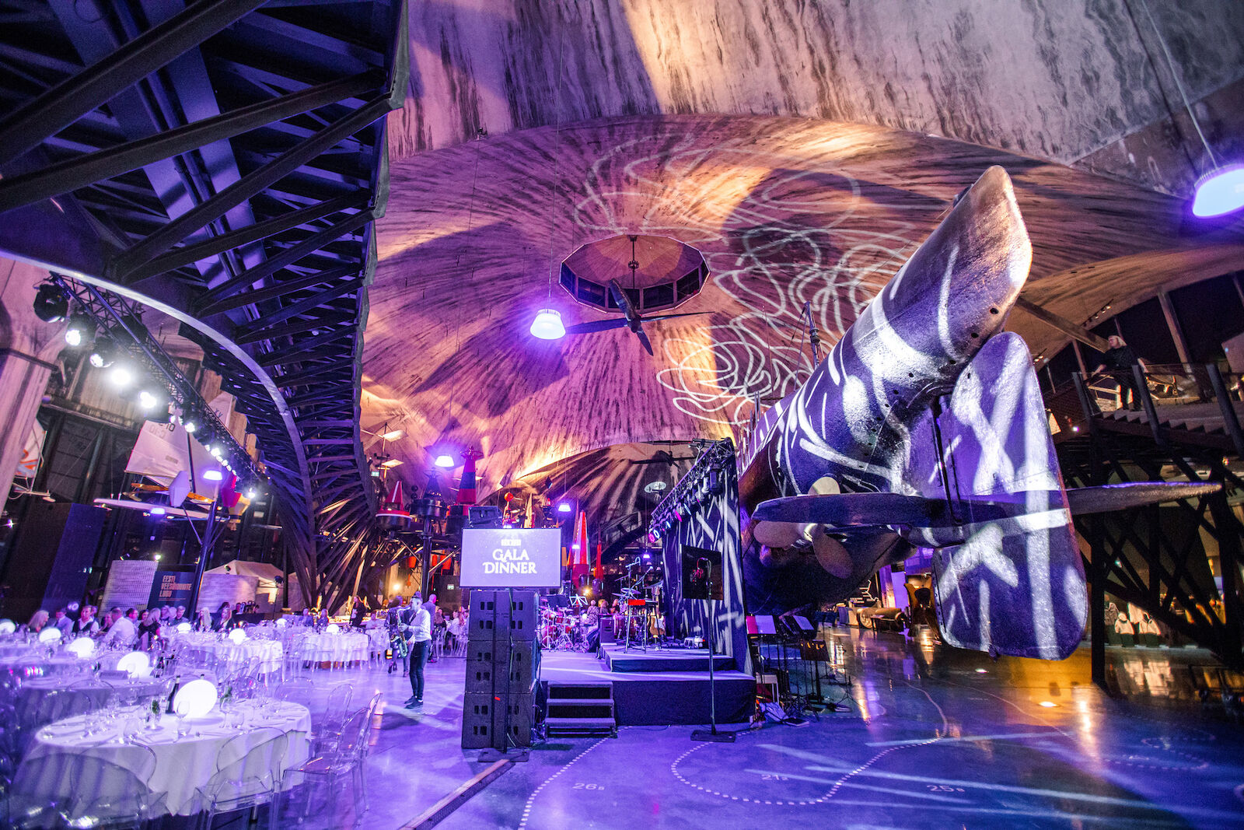
Seaplane Harbour
the most exciting maritime museum in Northern Europe
receptions for 1500 guests
gala dinners 800 guests

Slide 25
Port of Tallinn Cruise
Terminal
© Priit Grepp
events up to 2000 guests
main hall can be divided into 3 rooms
sustainable building

Slide 26
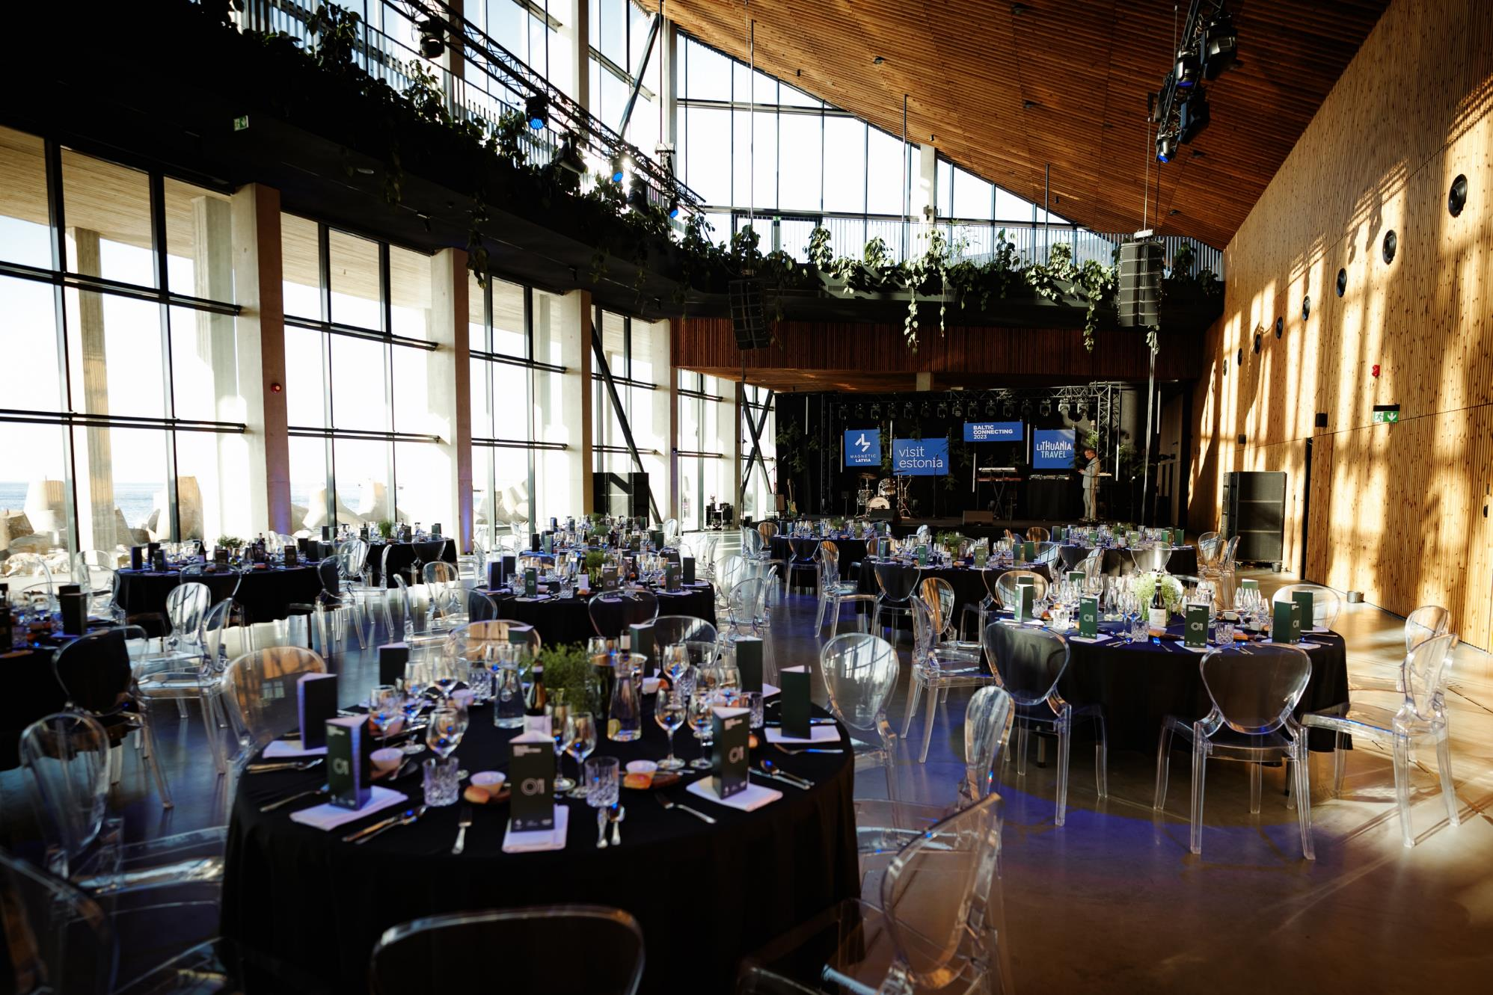
Port of Tallinn Cruise Terminal

Slide 27
Proto Invention Factory

Slide 28
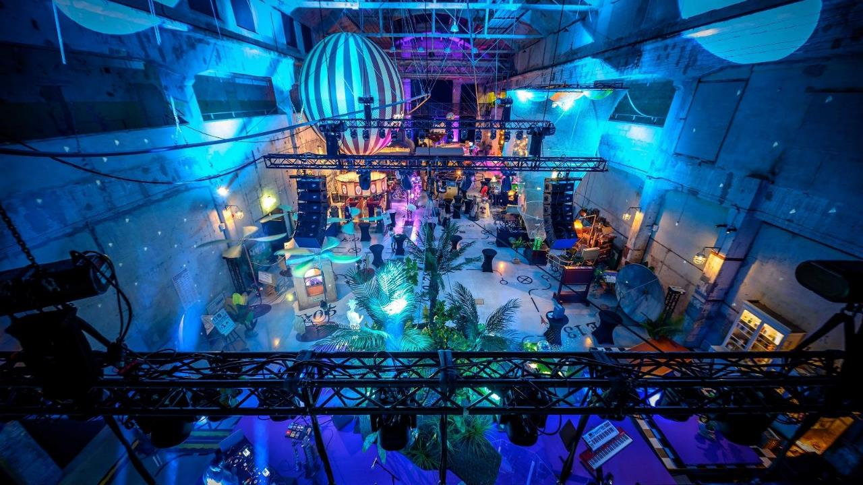
Proto Invention Factory
19th-century discoveries and inventions
virtual reality and hands-on
max 600 guests for reception
max 220 guests for seated gala dinner
6 meeting rooms
located in Noblessner Port District

Slide 29
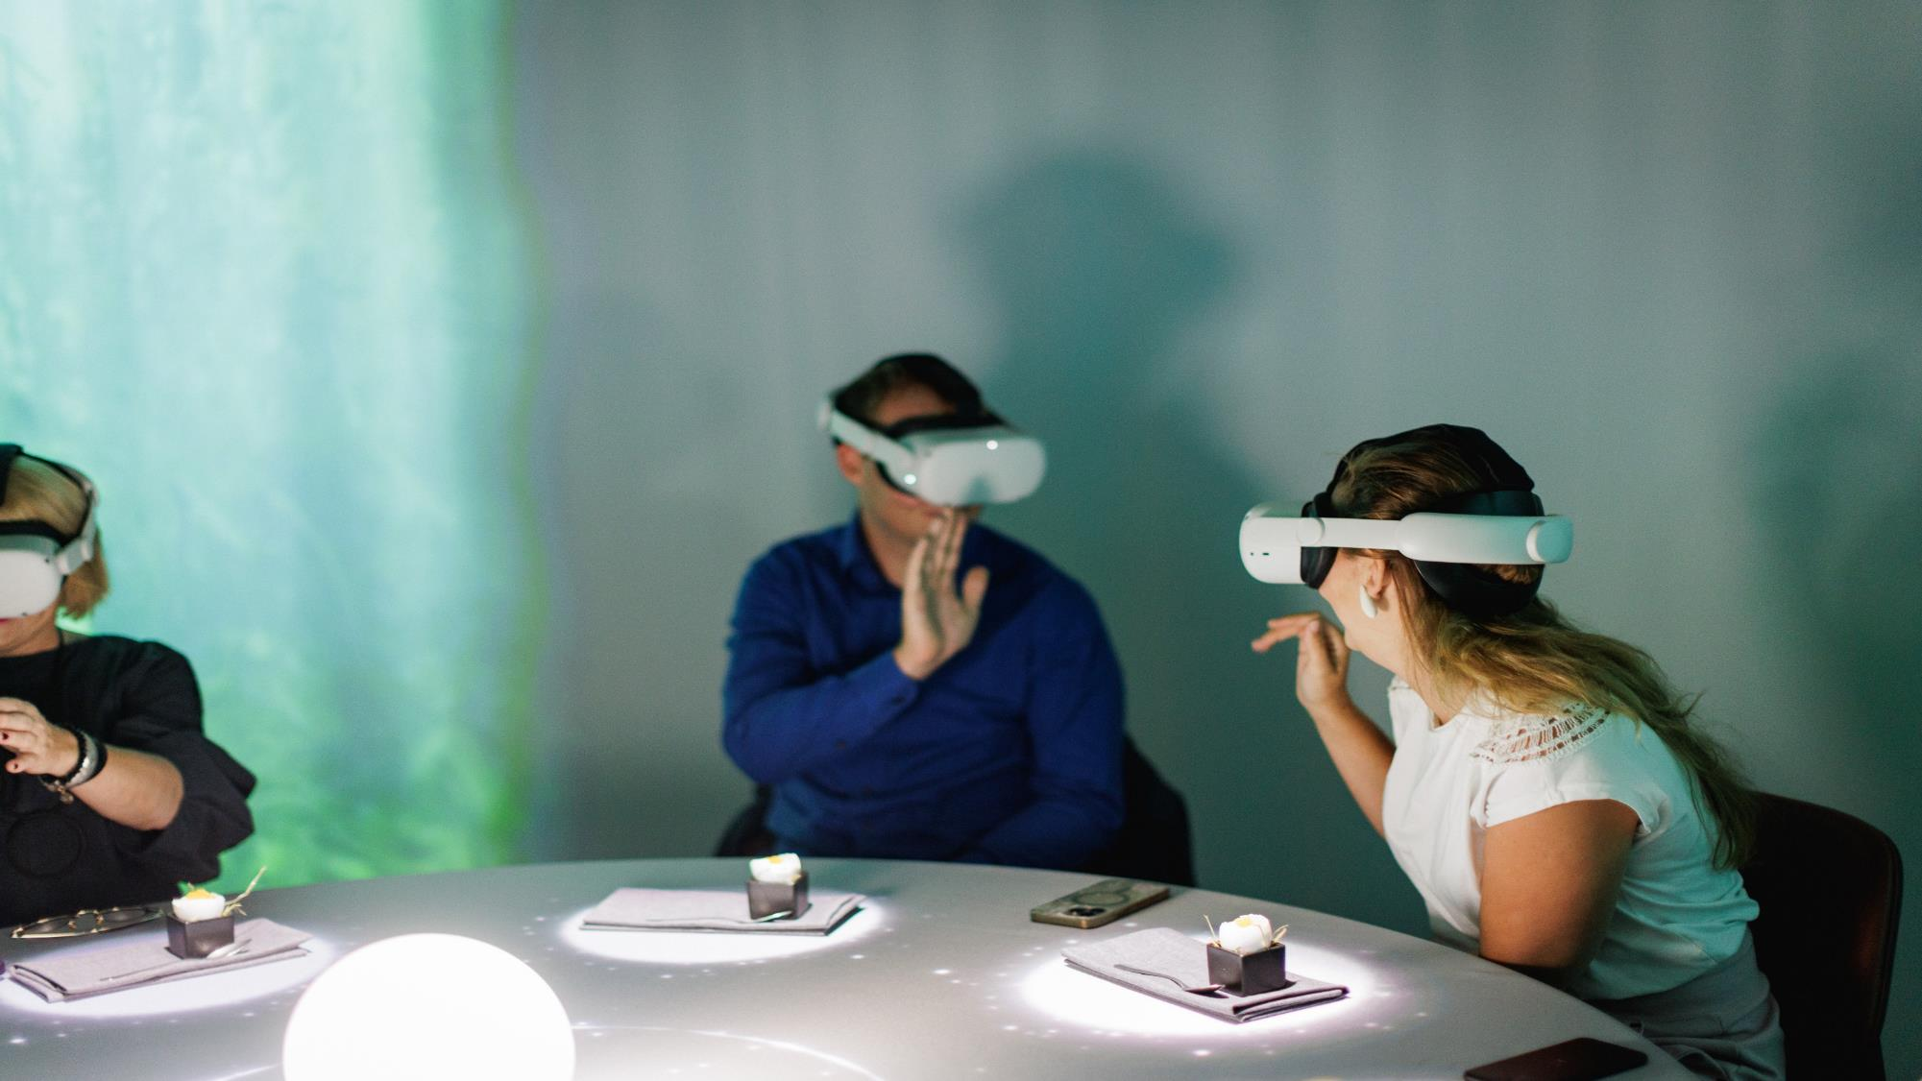
Proto Invention Factory
Virtual reality dinner experience
4-course journey through the flavours of Estonia
max capacity 40pax

Slide 30
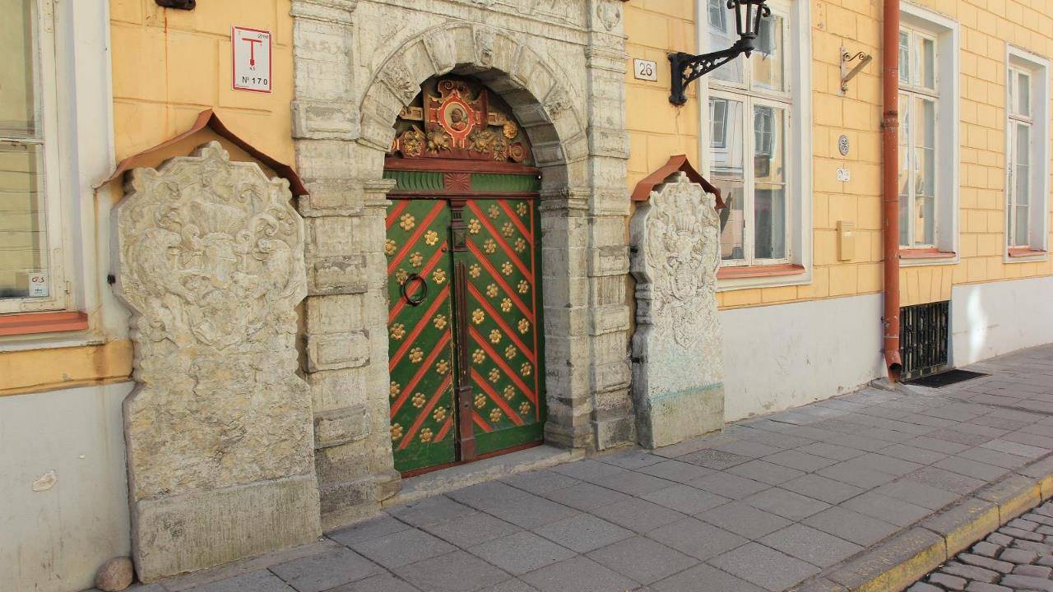
House of Brotherhood of Blackheads
located in Tallinn Old Town
8 unique rooms
meetings, concerts, dinners, receptions

Slide 31
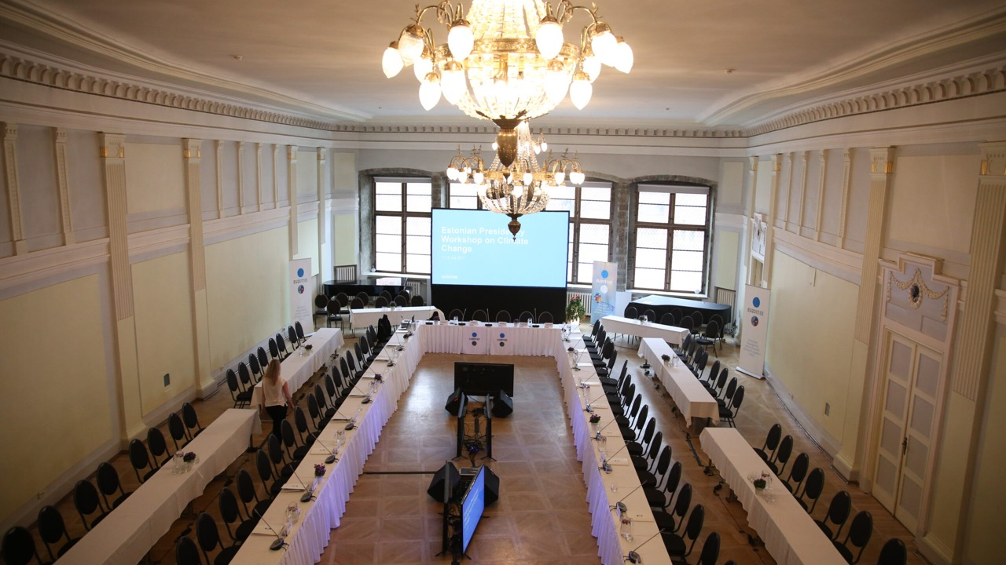
House of Brotherhood of Blackheads
White hall
gala dinner 200 guests
reception 400 guests

Slide 32
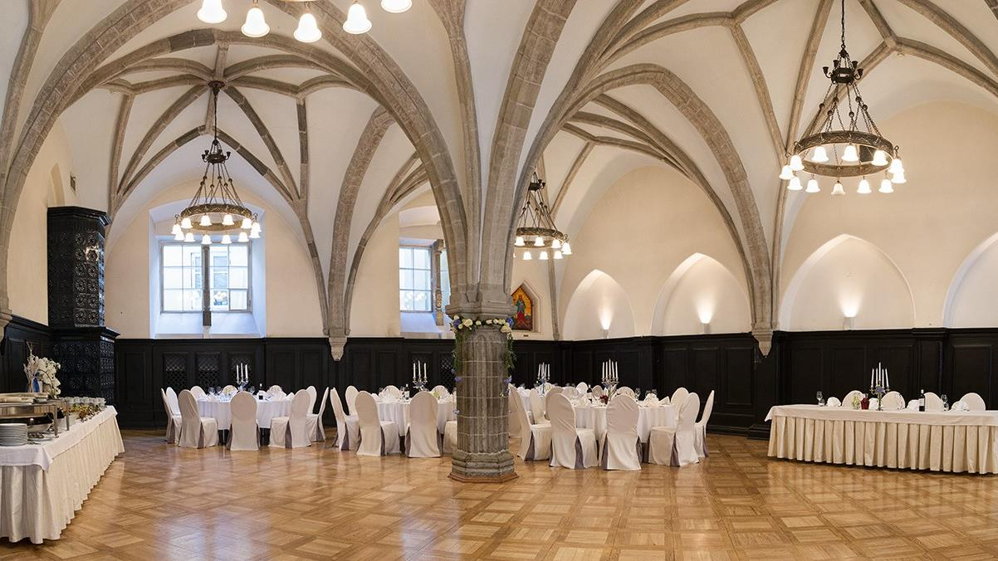
House of Brotherhood of Blackheads
Olav hall
buffet dinner 90 guests
reception 600 guests

Slide 33
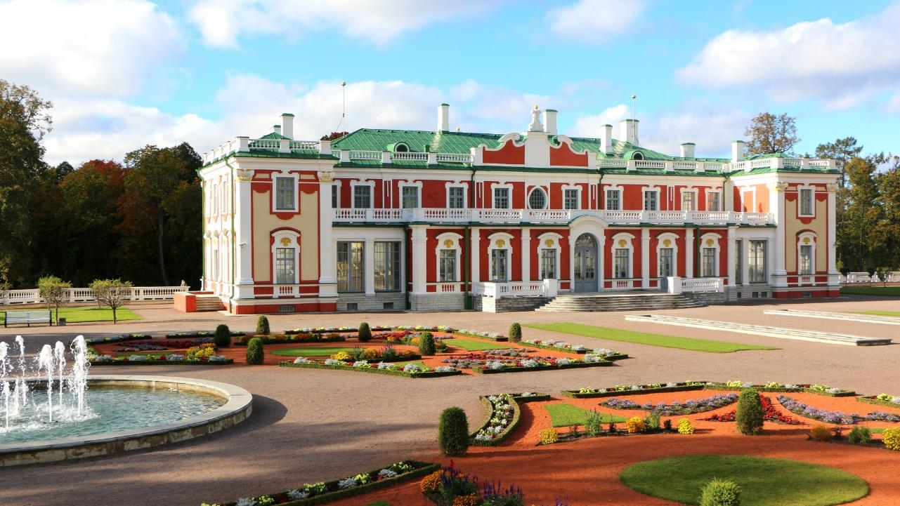
Kadriorg Palace Art Museum
Kadriorgin palatsi
Tilaisuudet maks. 220 henkilöä

Slide 34
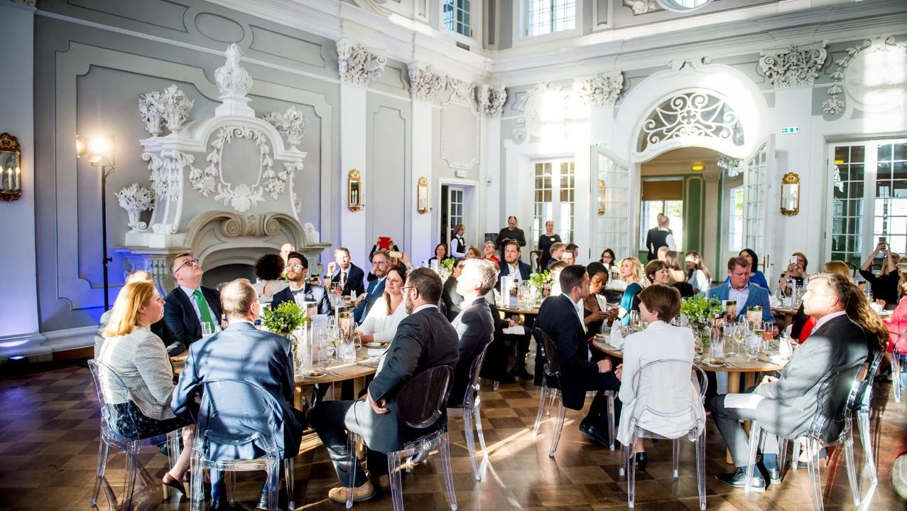
Kadriorg Palace Art Museum
max 220 guests
Perfect for business lunch or gala dinner

Slide 35
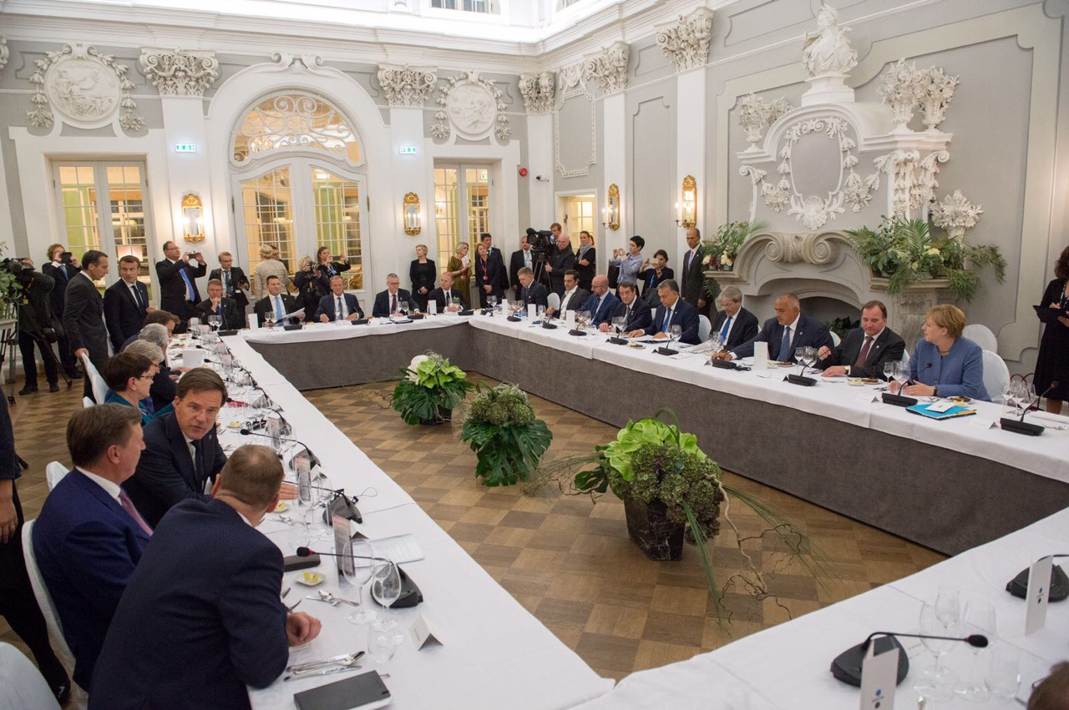
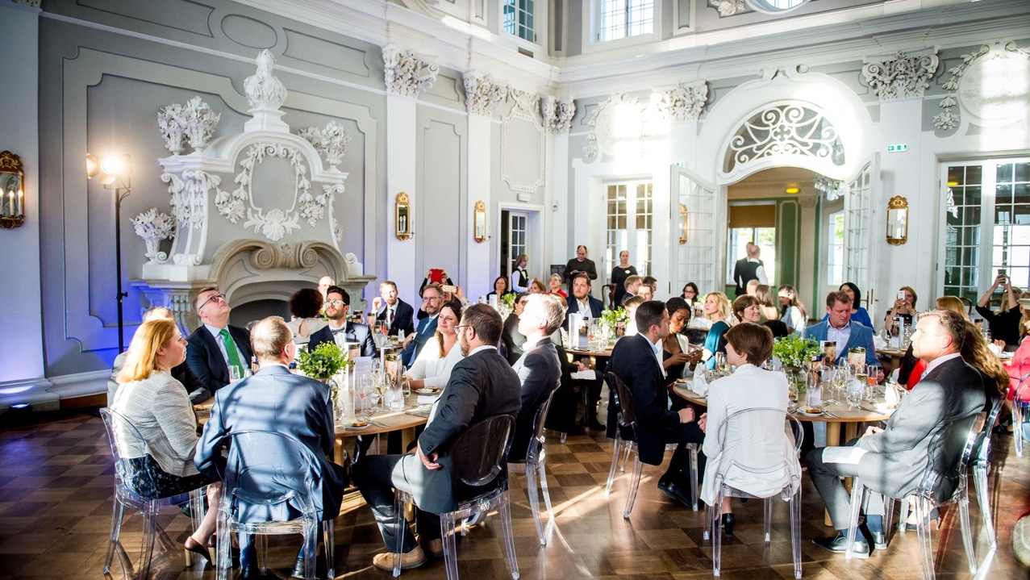
Kadriorg Palace Art Museum
max 220 guests
high level meetings

Slide 36
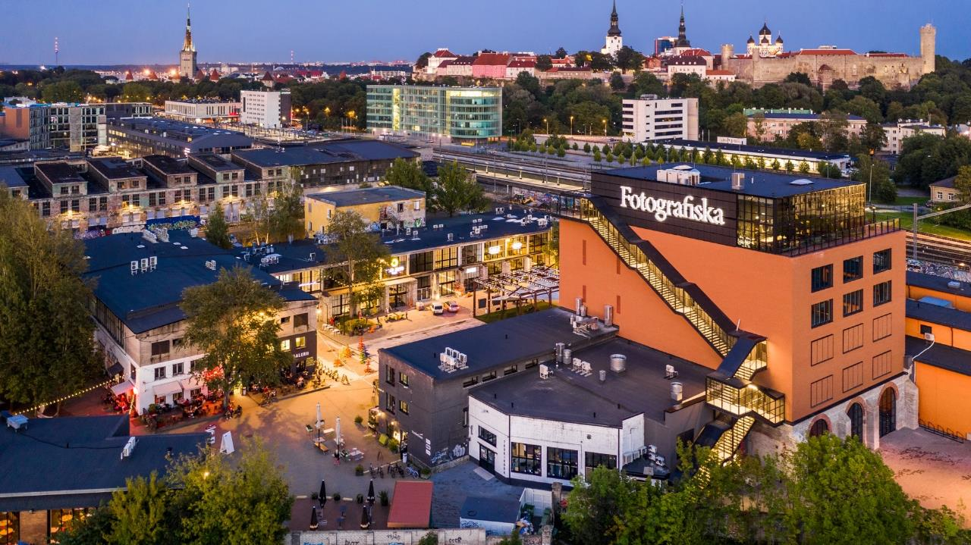
Fotografiska Tallinn
a satellite gallery of Stockholm’s renowned photography museum
260 guests for events

Slide 37
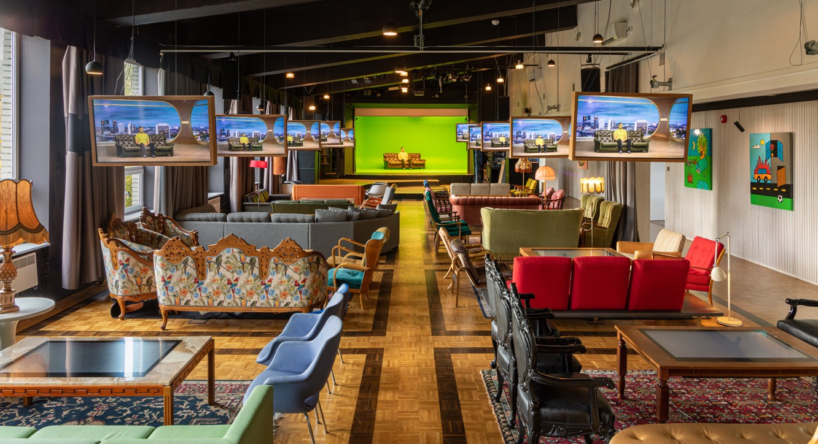
Club of Different Rooms
4 meeting rooms
max 250 person for a meeting

Slide 38
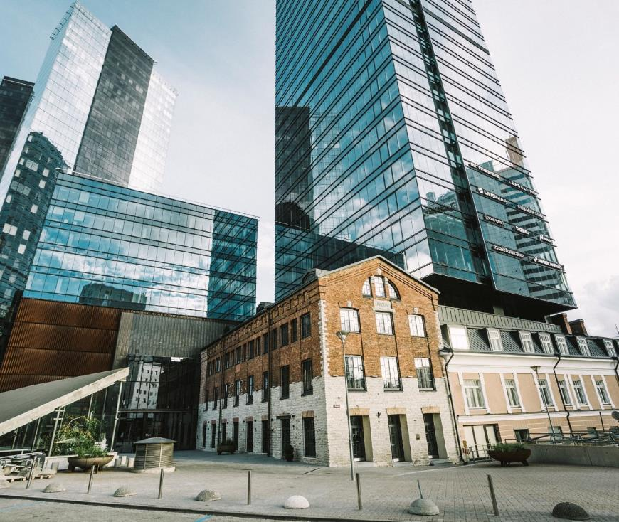
Excellent quality business hotels
Wide range of 3-5 star hotels from international chains to boutique properties
7,600 hotel rooms in total in Tallinn
Plenty of Green Key hotels

Slide 39
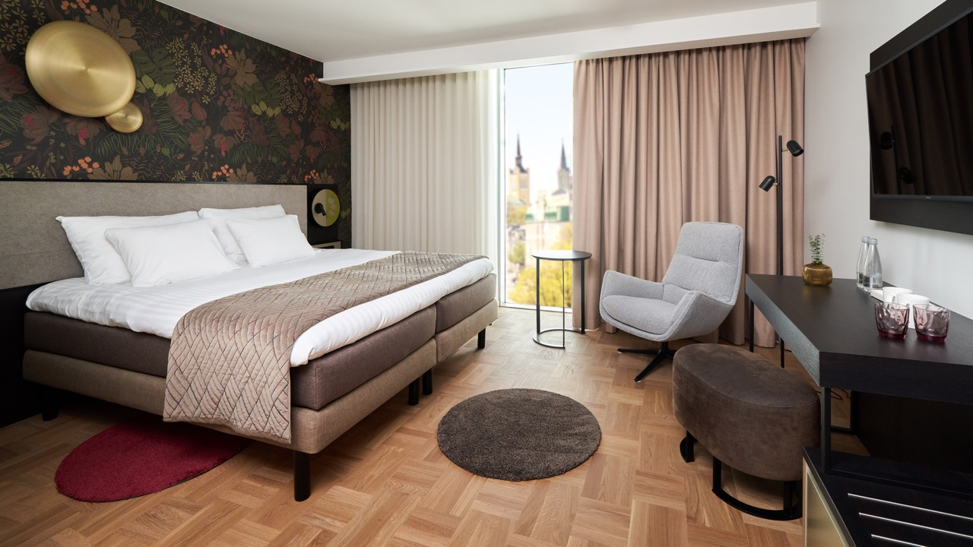
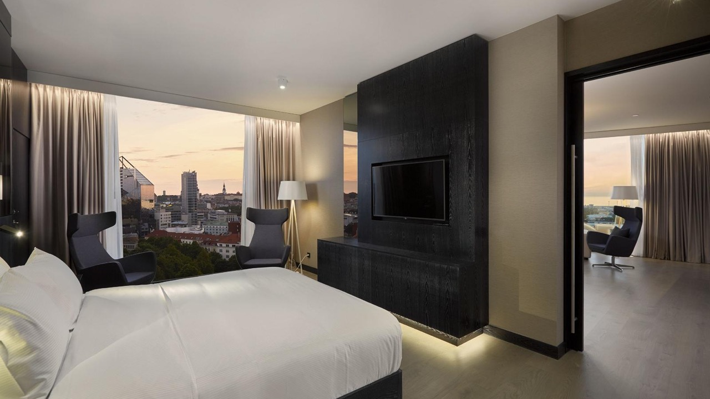
better still - good value for money
© Rasmus Jurkatam
spacious,
rooms, great value for money
breakfast always included
free wireless internet in every guest room

Slide 40
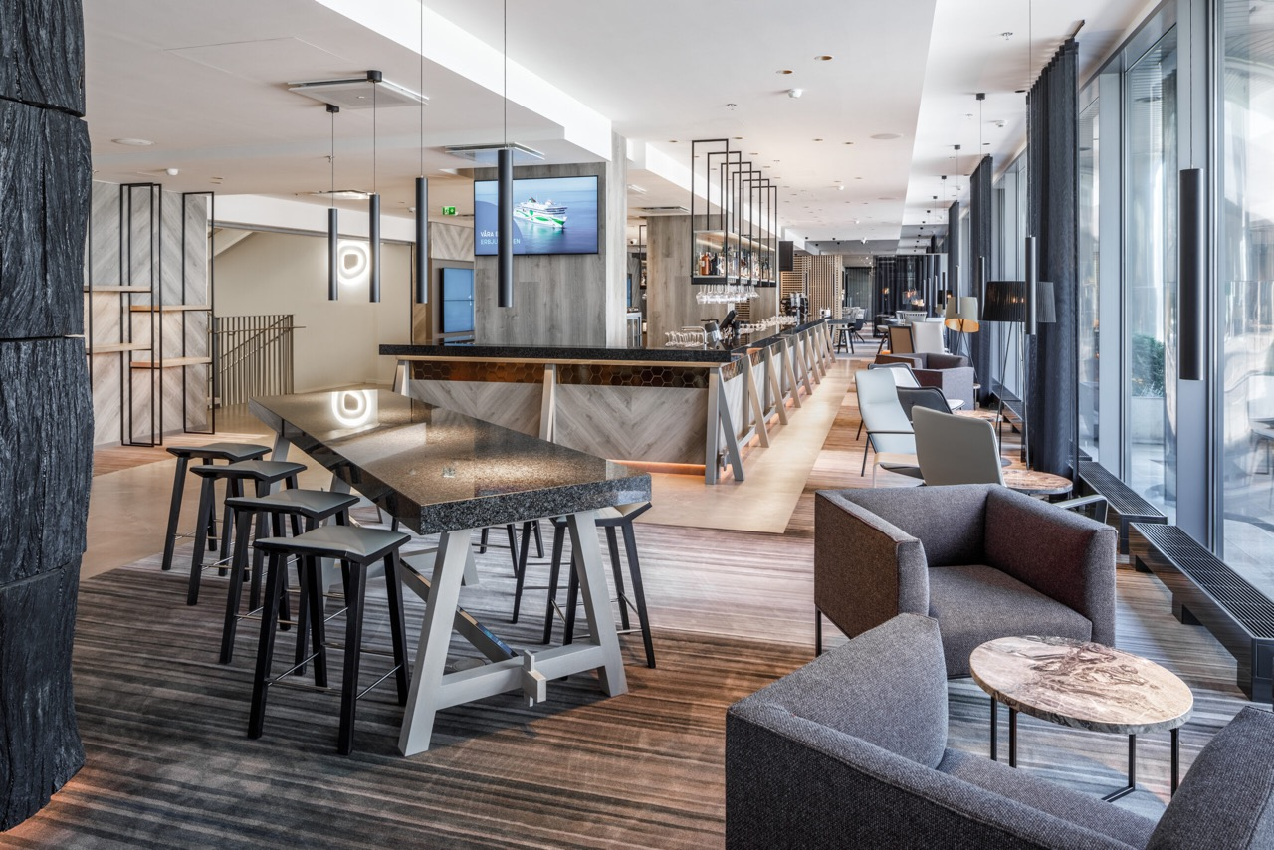
better still - good value for money
recently renovated hotels
© Rasmus Jurkatam
breakfast always included
free wireless internet in every guest room

Slide 41
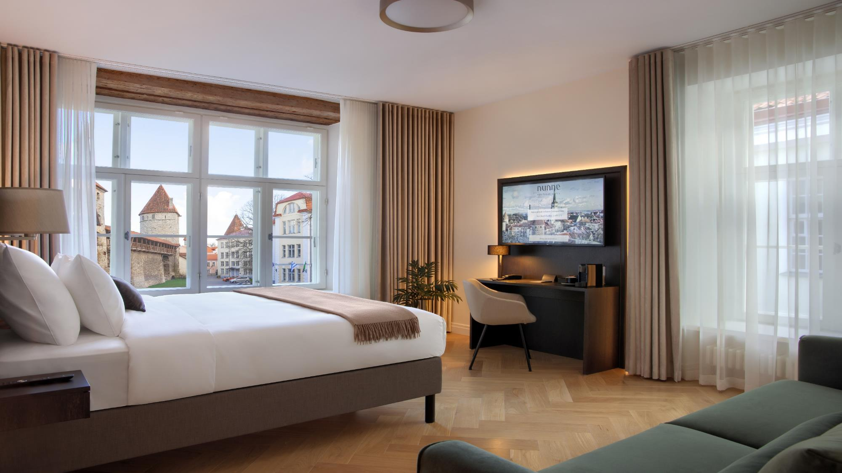
boutique hotels in Tallinn old town
© Rasmus Jurkatam

Slide 42

Modern meeting facilities in hotels
Largest meeting rooms up to 530 guests theatre style; breakout rooms for parallel sessions

Slide 43

business class hotels with modern meeting facilities
© Hotel L´Embitu

Slide 44

many hotels have spa or relaxation area

Slide 45

think outside of the box sleep inside the box
© Hotel L´Embitu

Slide 46













ECB member hotels

Slide 47


mouth-watering restaurants
local, seasonal, Nordic style modern food
Top-notch Michelin - restaurants

Slide 48

Restaurant 180°
by Matthias Diether
120 seats
Chef’s table 10 seats
Located in Noblessner Port district

Slide 49

Restaurant 180°
by Matthias Diether
Two Stars: Excellent cooking

Slide 50

street food restaurants

Slide 51

medieval feast at rich merchant’s home
© Starmaker OÜ
no electricity, only candles
no potatoes or Coca Cola, none in Estonia in medieval times
Olde Hansa restaurant offers 300 seats
option to privatize one floor for your group (max 80 seats)

Slide 52

zero waste restaurant on top floor of Fotografiska
Michelin Green star 2022
amazing views on old town
80 guests inside
50 guest on terrace

Slide 53

reused industrial buildings turned into hip and cool restaurants
Lore Bistrot
90 seats
80 seats on the terrace
located in Noblessner Port district

Slide 54

located in hip and cool districts where locals like to meet

Slide 55

Awesome
Group Activities

Slide 56

Medieval
Legends Walking Tour

Slide 57

digital city adventures

Slide 58

we have built our digital society and we can show you how
© Ajujaht
visit e-Estonia briefing centre
get to know the story of our everyday life
self-driving vehicles
door-to-door delivery robots
smart street lighting
smart bicycle parking
startup community

Slide 59



bike sightseeing

Slide 60


make your own souvenir

Slide 61

marzipan painting

Slide 62

food sightseeing

Slide 63

cooking class

Slide 64


Jaanihanso Cider Farm
visit distilleries & craft breweries

Slide 65


forest hike & learning about the nature

Slide 66

bogshoe walk

Slide 67

E-fatbike tours
Porsche Ring
+ near Pärnu, 1,5 hr from Tallinn

Slide 68

pop up forest restaurant

Slide 69

be mindful with
SUP board yoga

Slide 70

surprise choir concert in the bog or during forest hike

Slide 71


hands-On Orienteering Game
+ in Kõrvemaa, 40 min drive from Tallinn

Slide 72


rally racing
+ in Laitse, 40 min drive from Tallinn

Slide 73

Rally Racing
rally racing

Slide 74


demolition derby
Porsche
Ring
+ in Männiku, 30 min drive from Tallinn

Slide 75

Rummu Quarry - a landscape to remember
+ former prison turned into an adventure centre
+ 40 min drive from Tallinn

Slide 76

lighted raft tours

Slide 77

plant a tree

Slide 78


Tartu – European Capital of Culture 2024
Estonia´s 2nd largest city
Population 95,000
1,200 hotel rooms
Distance to Tallinn: 185 km

Slide 79

Tartu
Attracts conferences related to scientific and medical fields
11 Educational & Research institutions
Tartu University (1632) ranks among 1% best universities in the world

Slide 80

Pärnu -
the wellness capital
Population 40,000
Spa traditions since 1838
Distance to Tallinn: 130 km
2, 500 hotel rooms
Excellent networking activities

Slide 81


4
Spa hotels
with meeting facilities

Slide 82
Porsche Ring
+ near Pärnu, 1,5 hr from Tallinn

Slide 83

Local Support for Conferences
Enterprise Estonia
Tartu City
Tallinn City
Support sum max 30,000 euros
Minimum estimated international delegates 75/120 depending on the month
Duration min 2 days
Free public transportation for conferences and events in Tallinn
Support sum 7,500 - 30,000 euros, max 70 % of the total costs
Minimum 120 international delegates
Duration of the conference program at least two consecutive days

Slide 84

Tallinn city offers free of charge public transportation for conference delegates

Slide 85
Top reasons to choose Estonia for your next conference
New and fresh destination in Europe
World’s leading digital society
Key Sectors of excellence including E-Health
Estonian Health Tech Cluster & vibrant startup scene
Cosy and compact with easy logistics
Excellent quality business hotels
Multifunctional unique event venues
Amazing food (seasonal, local, short-travelled)
Great value for money
Easy organising: euro as a currency, English widely spoken, Nordic business culture
Green and clean, sustainability is a way of life
Tartu European Capital of Culture 2024

Slide 86


Experienced partners
at your assistance
Estonian Tourist Board, Visit Estonia
Estonian Convention Bureau
Visit Tallinn Convention Bureau
Baltic Tours DMC
Baltcoming
Go Travel
Hilton Tallinn Park Hotel
Mövenpick Tallinn Hotel
Nordic Hotel Forum
Radisson Collection Hotel, Tallinn
Swissôtel Tallinn

Slide 87


We are looking forward to welcoming you in Estonia!
Dana Noormets
Kadri Karu
dana.noormets@eas.ee
kadri.karu@ecb.ee
visitestonia.com
www.ecb.ee

